Slide 1
Functional API

Slide 2
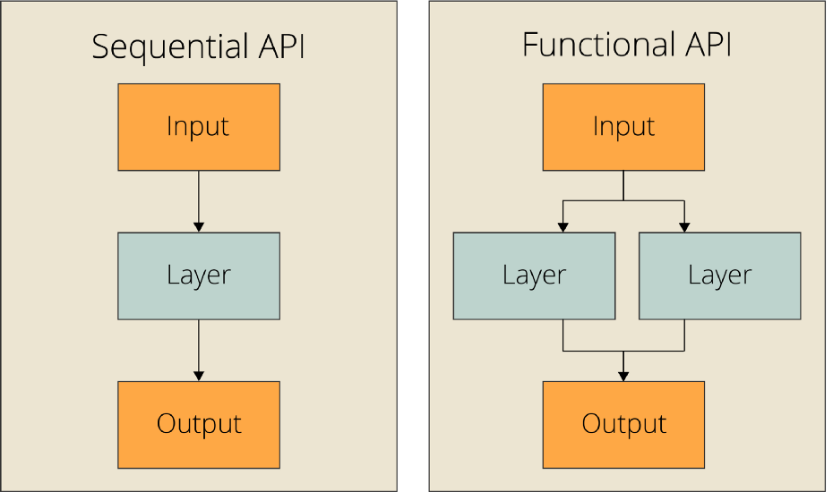
Quick Explanation / Syntax
Functional vs. Sequential API (vs. Subclassing)
Creating Keras models with the Sequential class vs. the Functional API
Custom Loss functions
Using TensorBoard to monitor training and evaluation metrics
Writing training and evaluation loops from scratch

Slide 3
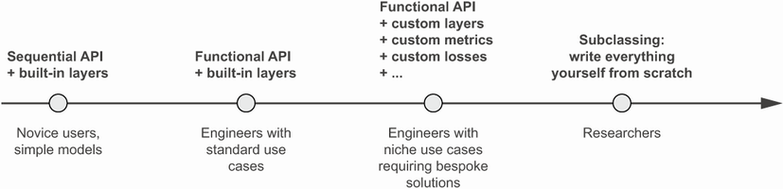
Alternative Options /w Keras

Slide 4
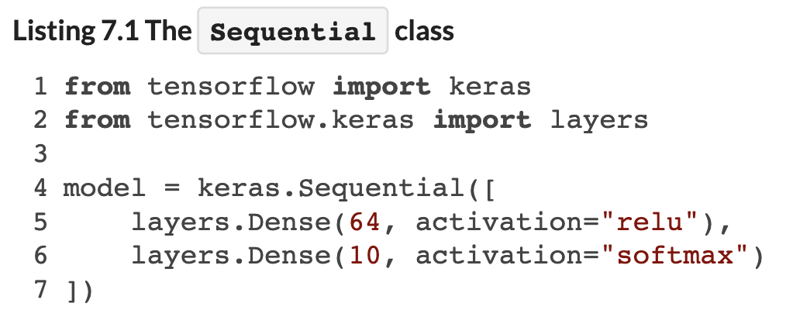
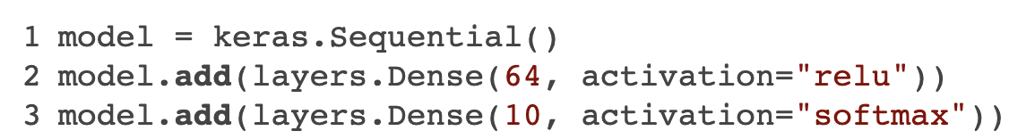
Define Architecture via Sequential API
Same Thing, but Adding Layers Dynamically

Slide 5
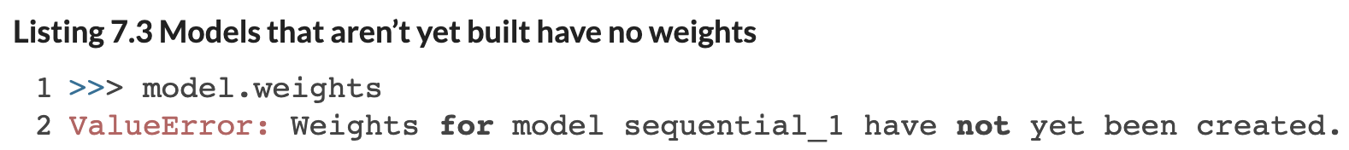
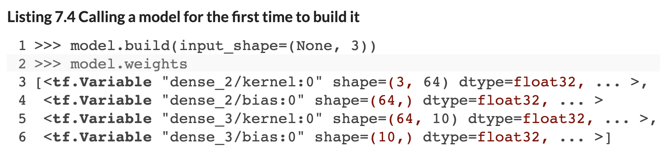
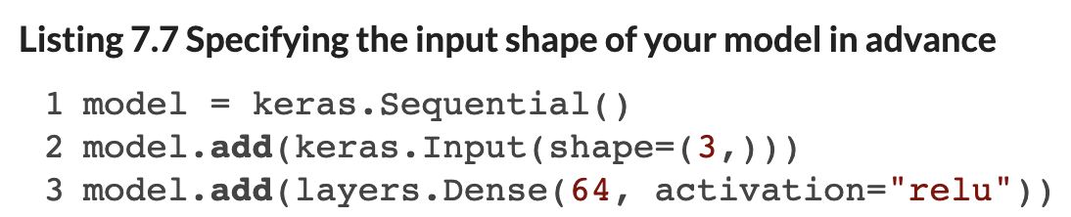
Sequential Model Initialization and Input Shape

Slide 6
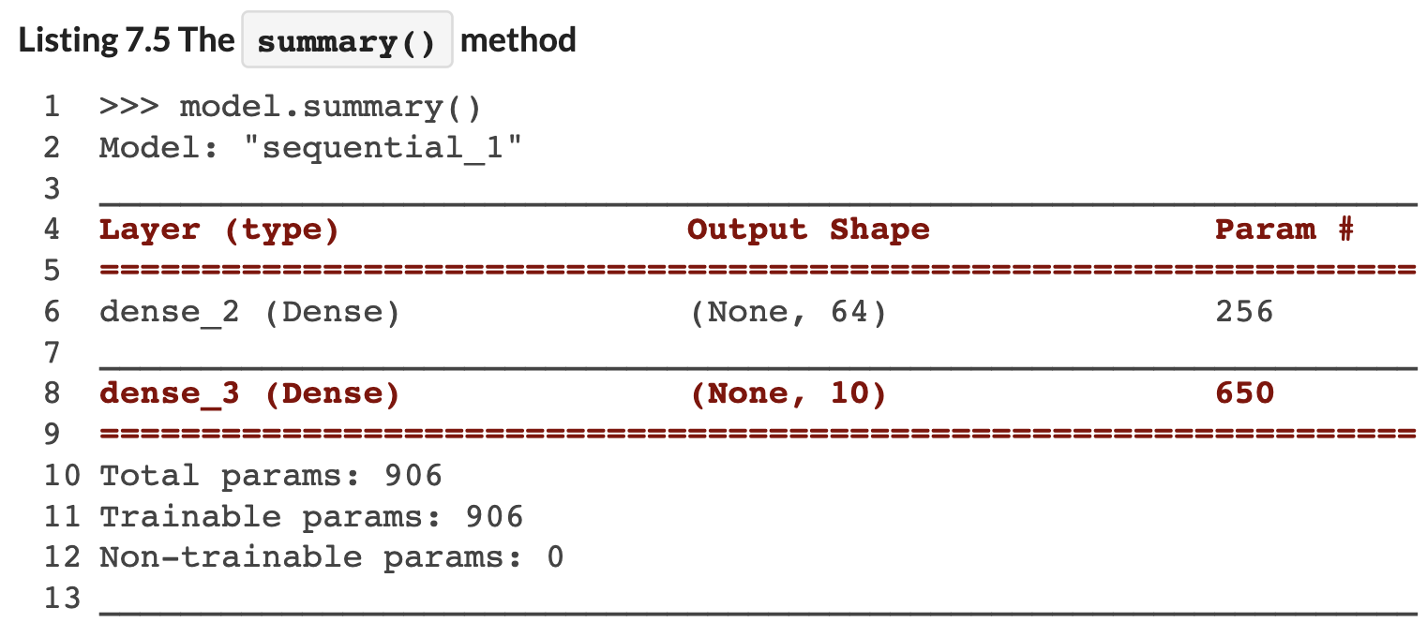
Summary Function

Slide 7
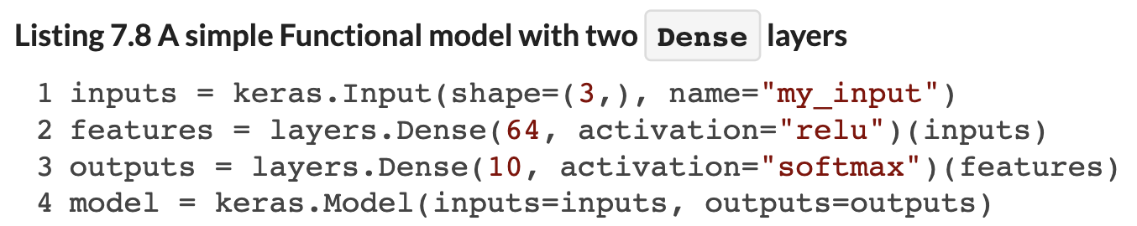
Define Architecture via Functional API
Define Each Layer and its Linkages (If Any)
When you specify a given layer, you state what input it takes (if any).
This lets you build more complicated topologies (e.g., branches, multi-outputs, letting earlier layers feed into later layers in the network, and so on.

Slide 8
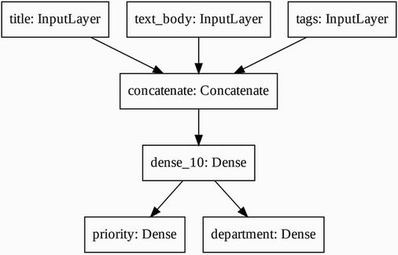
Functional API Enables Complex Architectures
We Can Define a Multi-Input (Branches) to Multi-Output (Labels) Topology
This because useful for multi-modal data, or for introducing feedback loops, etc. into the network.
Notes:
Weights are not initialized until you “build” the model (or compile it, which will first build).

Slide 9
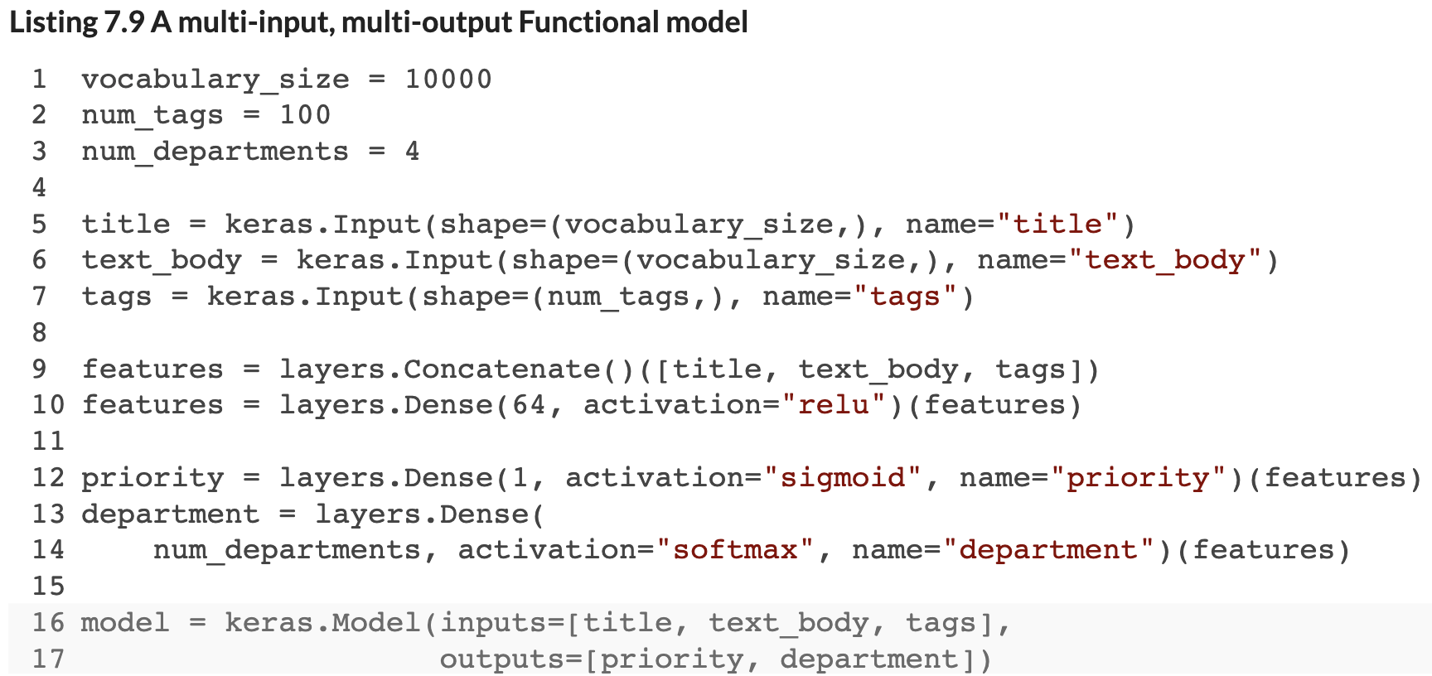
Functional API Enables Complex Architectures
We Can Define a Multi-Input (Branches) to Multi-Output (Labels) Topology
This is useful for multi-modal data, residual links, or feedback loops, etc.
Notes:
Weights are not initialized until you “build” the model (or compile it, which will first build).

Slide 10
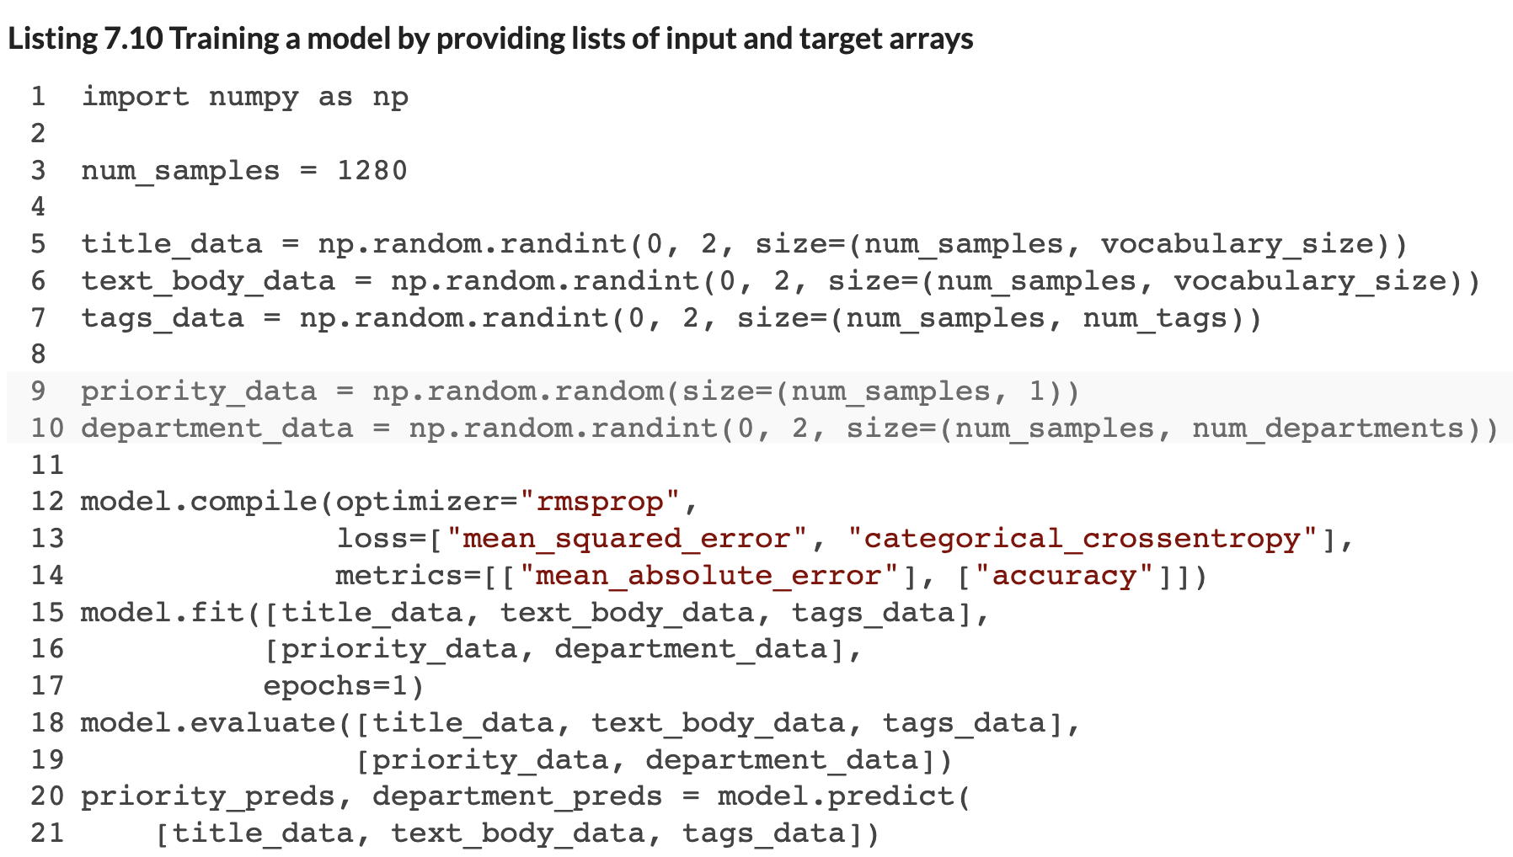
Training With Multiple Input / Output Layers
Pass Lists of Input / Output Arrays, and Specify Lists of Loss Functions / Metrics
We need to pass in a list of arrays addressing all inputs, as well as a list of labels for all outputs.
We can also provide a list of loss functions and metrics, one of each for each output label.
Notes:
Weights are not initialized until you “build” the model (or compile it, which will first build).

Slide 11
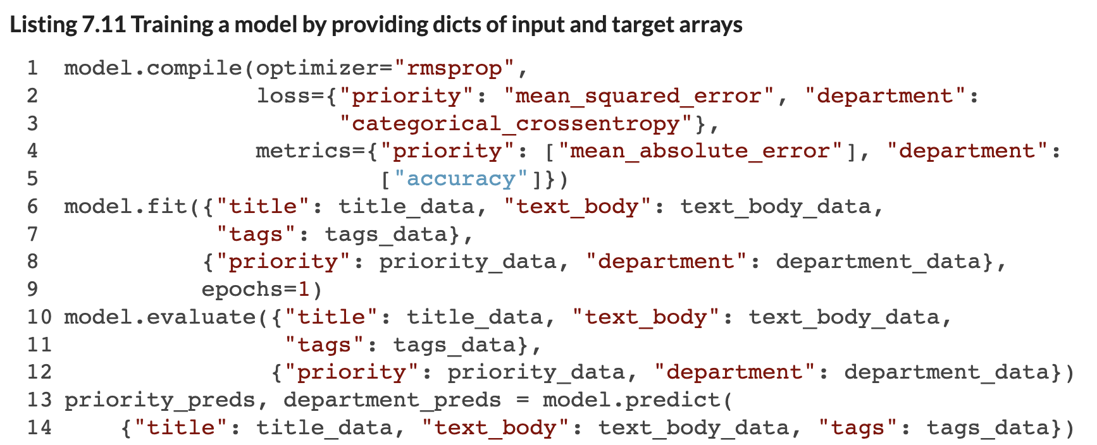
Training With Multiple Input / Output Layers
Pass Lists of Input Arrays, and Specify Lists of Loss Functions / Metrics
Use dictionaries rather than argument positional indexing (you are less likely to make a mistake this way!)
Notes:
Weights are not initialized until you “build” the model (or compile it, which will first build).

Slide 12
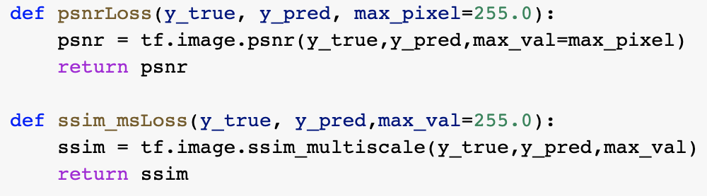
Define and Use Custom Loss Functions
We Can Write a Custom Loss Function
Many application-specific situations where we might want a custom metric (or loss function).
One example I will show you is image-sharpening – MSE or MAE are okay, but there are better metrics for image-wide alignment of pixel values.
Function That Accepts Predicted and Actual as Input
Notes:
Weights are not initialized until you “build” the model (or compile it, which will first build).

Slide 13
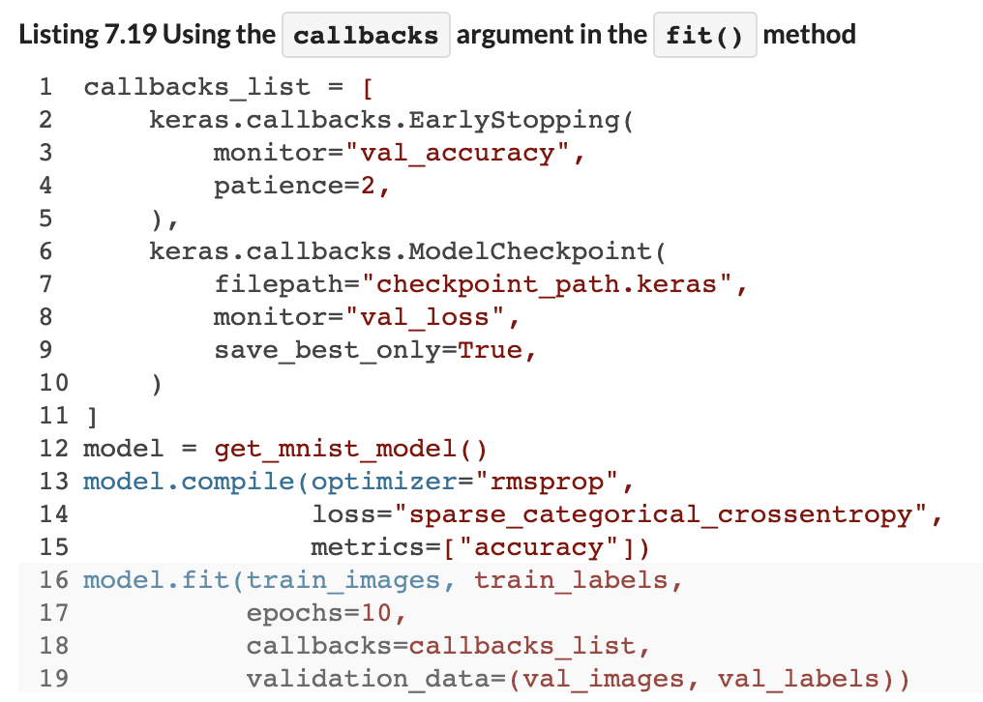
‘Callbacks’ in Training, e.g., Early Stopping
We Can Enforce Some Rules During Fitting
For example, we can tell the fit method to stop the training process early based on < threshold improvements in our objective function.
Notes:
Weights are not initialized until you “build” the model (or compile it, which will first build).

Slide 14
Save / Load a Pre-Trained Model
We Can Save and Re-load Models with Trained Weights for Later Use
This enables transfer learning, picking up where we left off…
We might load an old model, extract the first 5 layers, and then stack new layers on the end.
We might also fix the old model’s layers as non-trainable (‘calibrate’ a new model ‘end’ on top of the pre-trained model).
More on this shortly…
Notes:
Weights are not initialized until you “build” the model (or compile it, which will first build).

Slide 15
Questions?
Notes:
Weights are not initialized until you “build” the model (or compile it, which will first build).

